Slide 1

Department of Mechatronic Engineering
Mechatronic System Design (EK-408)
Capstone Project
Jan-Apr 2022
Group-4
Title: Remote Operated Herbicide Sprayer with Control Droplet Applicator for Palm Plantation.
Name | Student ID
1. Jayanth Kumar | 1001851644
Coordinator: Asso. Prof. Dr. Elango Natarajan
Supervisor: Wan Zailah Binti Wan Said

Slide 2
Introduction.
Farmers use chemicals to control pests and the growth of unwanted herbs. Traditional farmers spray herbicides or pesticides using Lever Operated Knapsack Sprayer.
By using this sprayer, the amount of chemicals sprayed is not controlled, and manual spraying results in affecting the farmers health due to direct contact with chemicals.
By using manual sprayer, the farmer might spray too much chemicals resulting in crop damage and reduces the fertility of the soil. In order to avoid the following issues, we have come up with Automated Spraying Robot which can be operated remotely.

Slide 3
Problem Statement.
Spraying herbicides or pesticides is one of the challenging task performed by farmers in agriculture field or palm plantation.
While spraying herbicides the farmers get into direct contact with chemicals which causes health hazardous problems.
Farmers wear gloves and masks to avoid health problems. But still the farmers are affected by heat stroke and other skin related diseases while working.
In such situations use of robotics for spraying in agriculture or palm plantation is a very imminent technological solution that increases productivity and efficiency.

Slide 4

Objective
To stop manual spraying on the real plantation with pesticides or herbicides. This will reduce the plant's excessive use of pesticide.
To build a spraying robot in such a manner that it can travel through rough and rugged terrains of palm plantations.
To control pumps, serial manipulator, camera and spraying robot remotely using mobile application.

Slide 5
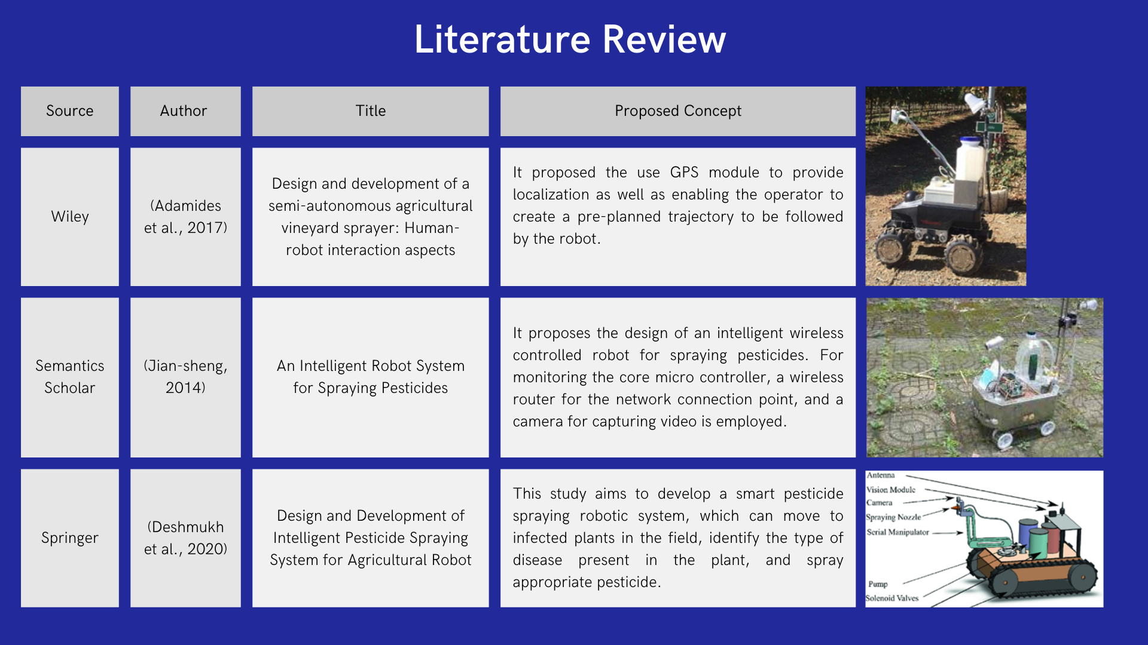
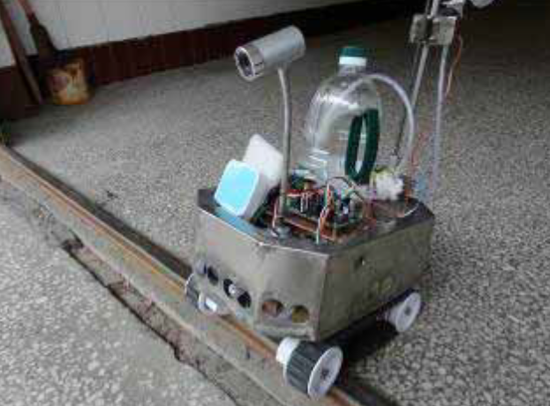
Literature Review.
Publisher | Author | Proposed Title | Proposed Concept
Springer | Deshmukh et al., 2020 | Design and Development of Intelligent Pesticide Spraying System for Agriculture Robot | In this study the aim was to develop a smart robotic system. Which directly goes to location of infected plant and sprays the chemical
Semantics Scholar | Jian-sheng, 2014 | An Intelligent Robot System for Spraying Pesticides | This study deals with an intelligent robot for spraying pesticides. This robot comes with a camera to view the path of robot

Slide 6
Customer Requirements
Parameters | Requirements
Technology | Robot must meet the current tech being used in the market Design should be unique
Operation | Must be able to operate remotely using mobile application
Costing | The robot be affordable and reliable
Spraying mechanism | Should be able to spray in areas where humans can’t reach
Performance | The robot must be able to move in all directions of the plantation.
Battery Efficiency | The robot should be able to operate for at least 3hrs The battery should be rechargeable
Capacity | The robot able to support weight up to 4kgs and should be carry this weight in plantation
Automation | Able to operate using remotely Mix water and herbicide automatically

Slide 7
Engineering Specification of Robot
Parameters | Engineering Specification Description | Comments
Technology | Tech used | Use of latest technology
Operation | Functional and efficient | Remotely operated
Costing | Low cost | -
Spraying mechanism | Angles of spraying Operational time | 180˚left/right, 180˚up/down
Performance | Proactive robot | Moves swiftly
Battery Efficiency | Source of power | Rechargeable
Capacity | Endurance of robot | ≤5kgs
Automation | Automated | -

Slide 8
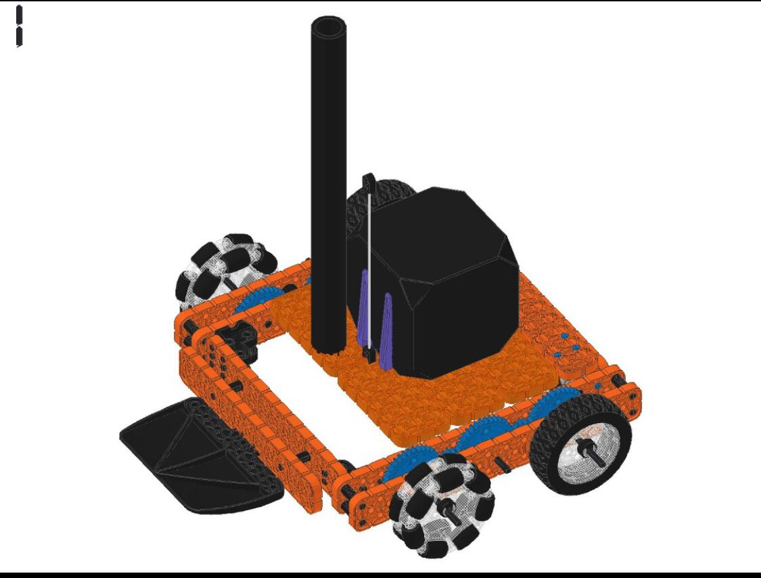
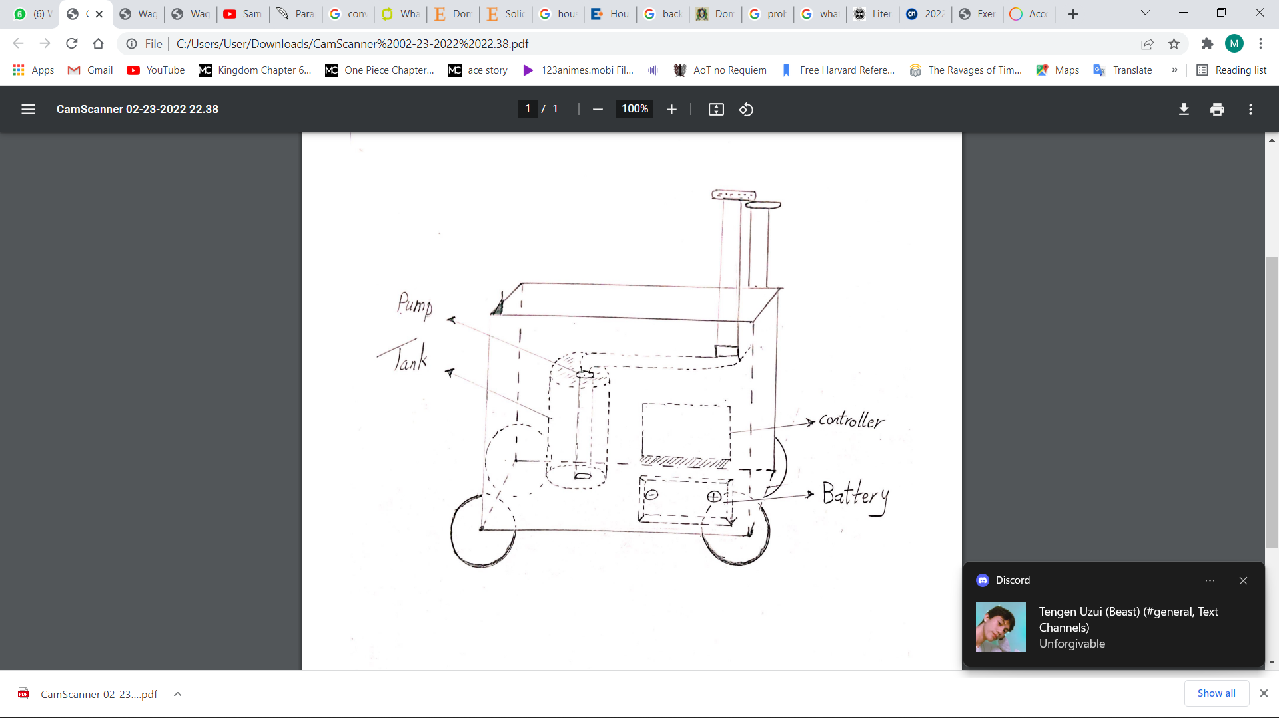
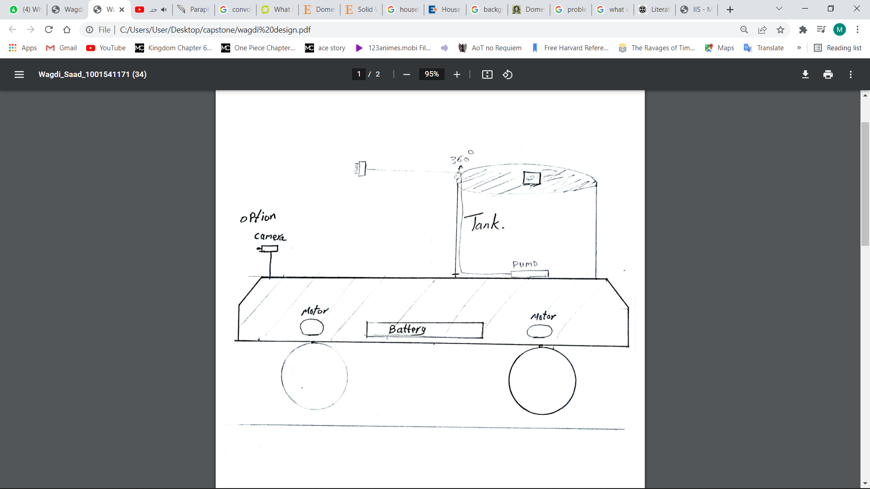
Conceptual Design.
Model-2
Model-1
Model-3
Model-4

Slide 9
Scoring Method using Decision Matrix
Parameters | Weightage | Model-1 | Model-2 | Model-3 | Model-4
Technology | 6 | - | - | + | -
Operation | 10 | - | + | + | -
Costing | 10 | + | - | + | +
Spraying Mechanism | 8 | - | - | + | +
Performance | 8 | + | + | + | +
Battery Efficiency | 6 | + | + | - | +
Capacity | 10 | + | + | + | -
Automation | 8 | - | + | + | +
Materials used | 5 | + | + | + | +
Total Scoring (+) | 38 | 47 | 39 | 65 | 45
Total Scoring (-) | 32 | 24 | 32 | 6 | 26
Total Count | 6 | 23 | 7 | 59 | 19

Slide 10
Features of the Robot.
Sprayer Hand that rotates 180˚ to spray herbicides.
Camera Module to avoid obstacles.
Precision Spraying Nozzle used.
User Friendly.
Remotely Operated Robot to avoid direct contact with chemicals.

Slide 11

Design Limitations
Robot Chassis Load Limitation.
Spraying Angle.
Range at which the robot can be operated remotely.
Battery Capacity.
Tanks Storage Capacity.

Slide 12
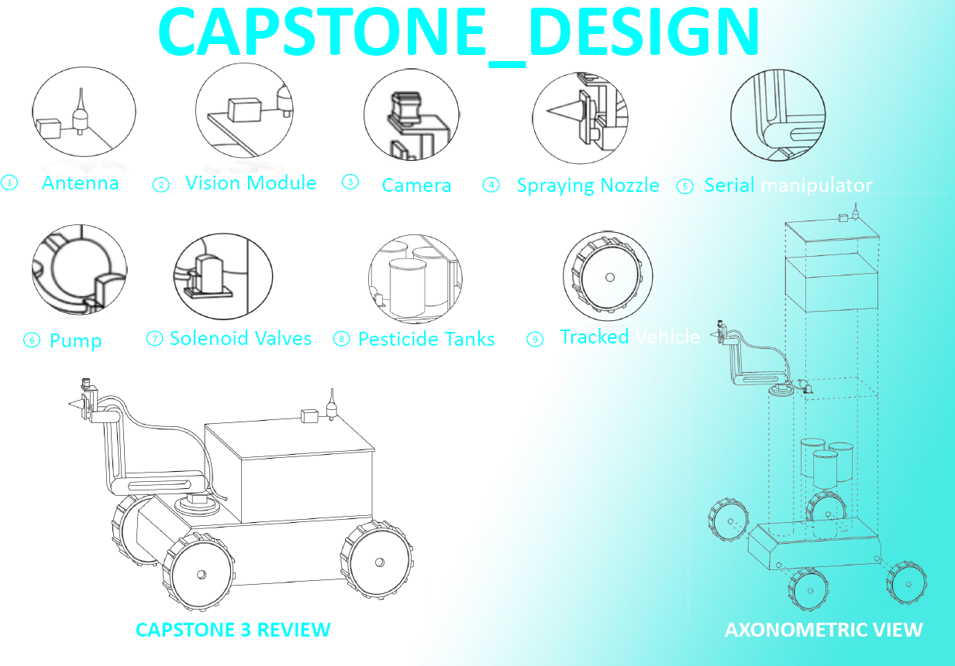
Final Design

Slide 13
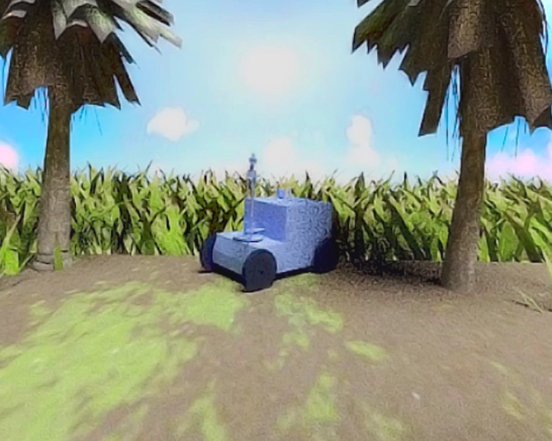
Animation of Prototype.

Slide 14
Prototype Building

Slide 15
System Architecture

Slide 16
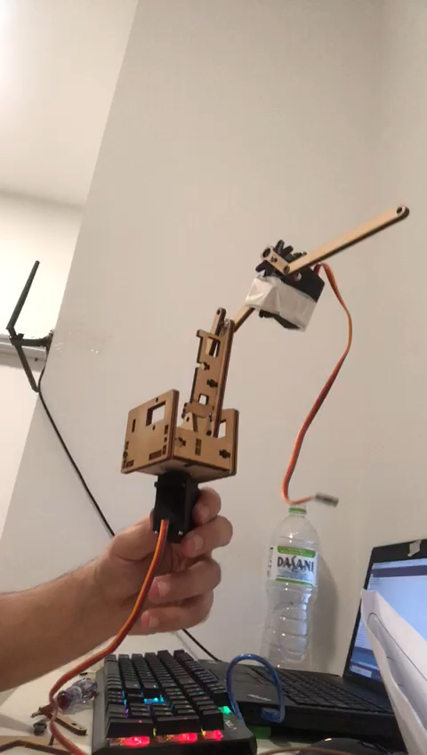
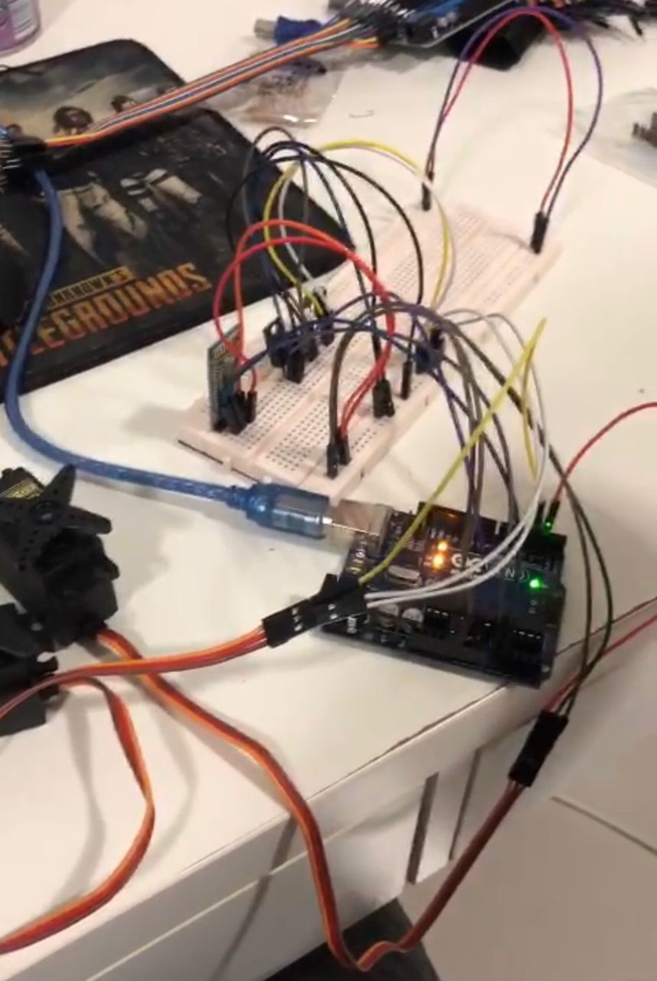
Testing Circuit On Breadboard

Slide 17
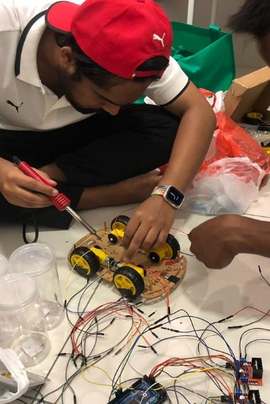
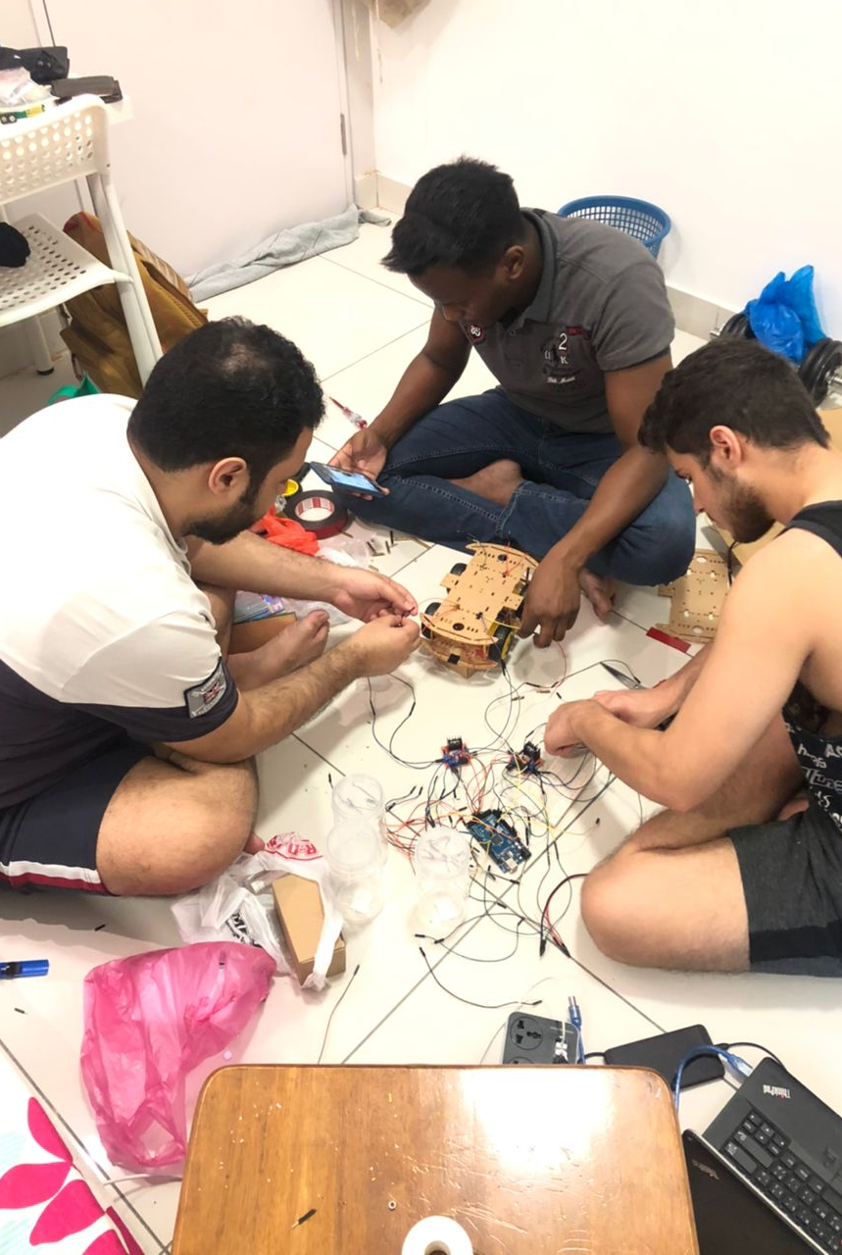
Chassis Assembly

Slide 18
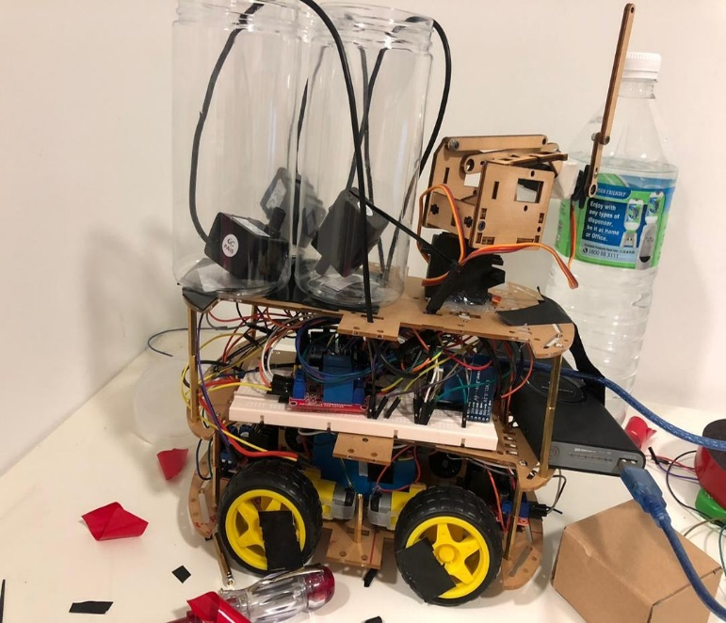
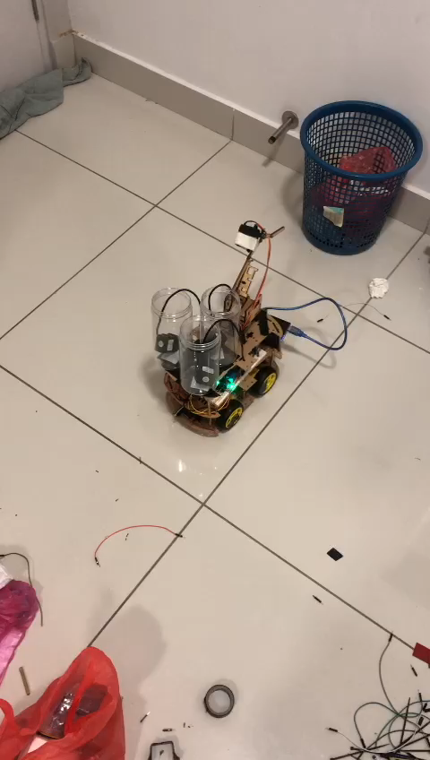
Testing the Prototype

Slide 19
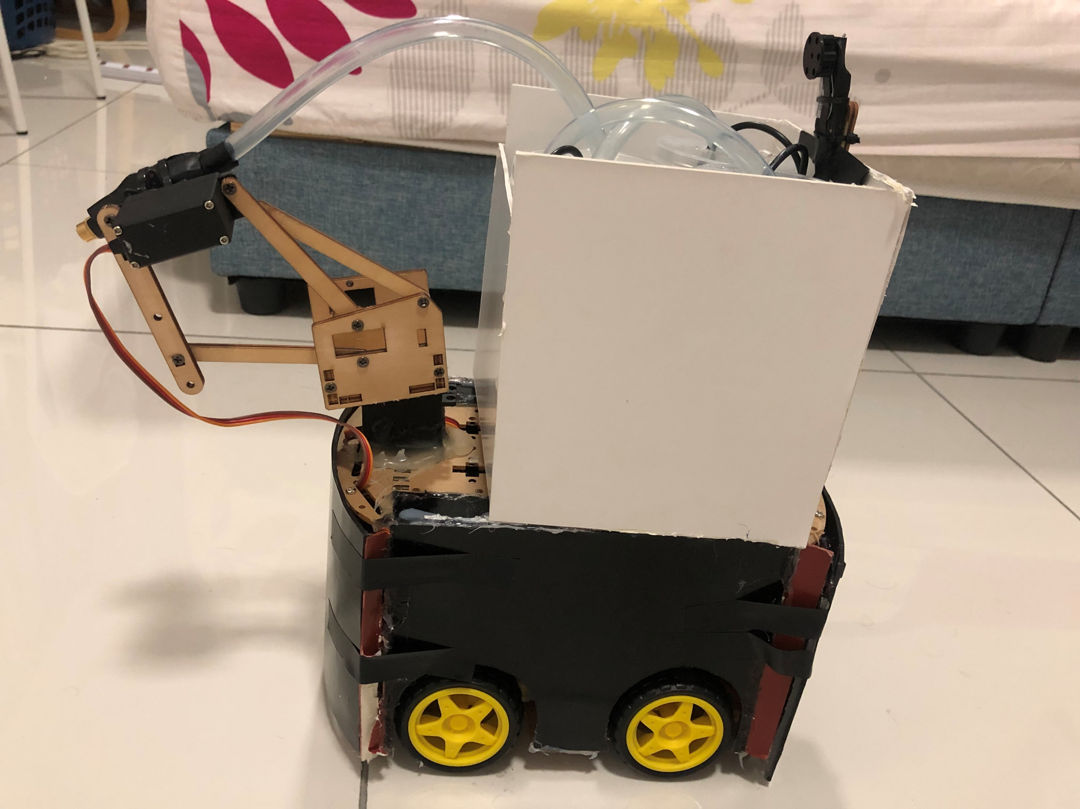
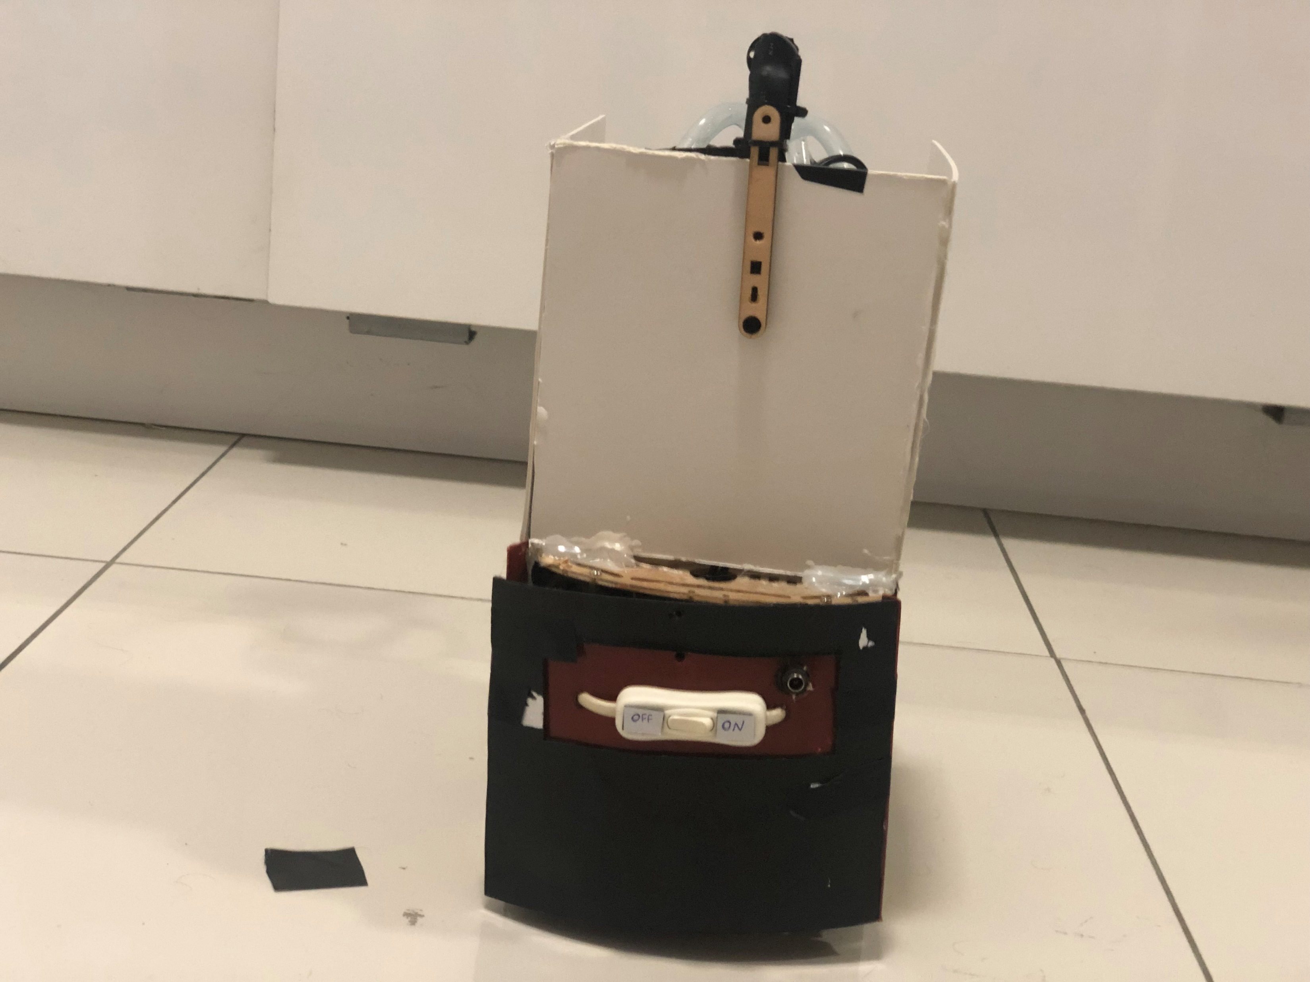
Final Look of the Prototype

Slide 20

Application of Remote Control on Mobile

Slide 21
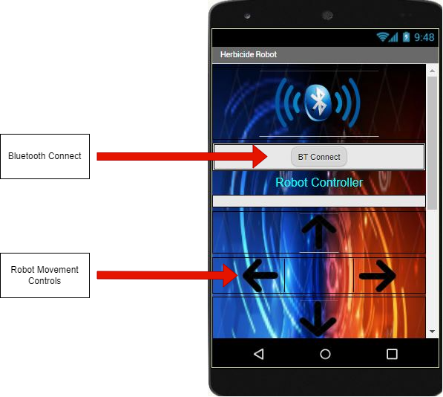
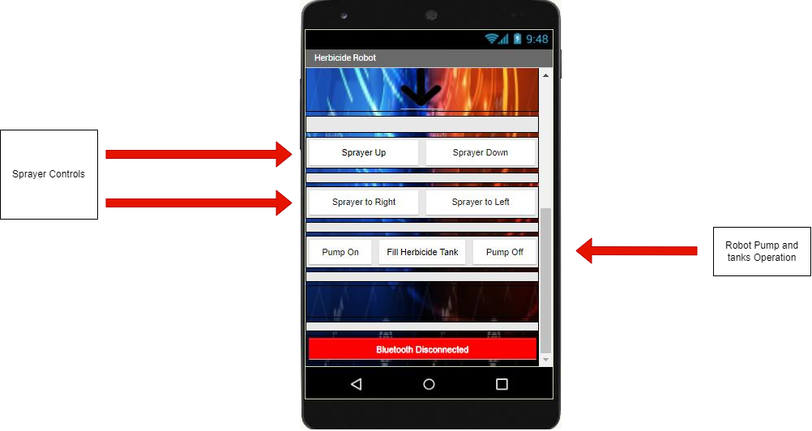

Slide 22
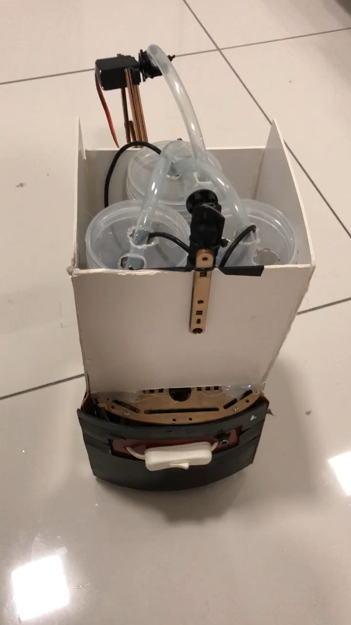
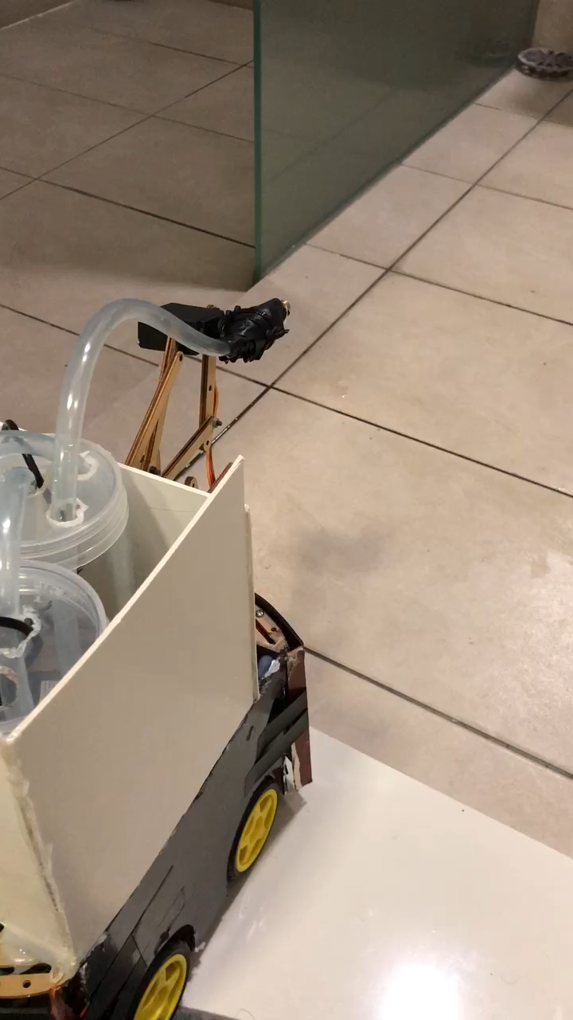
Final Testing

Slide 23
Costing
Components | Quantity | Price/Unit (RM) | Total Price (RM)
Arduino Mega R3 | 1 | 180 | 180
Water Pump 240L/H | 2 | 14.72 | 29.44
Diode Rectifier (1A/50V) | 4 | 1.24 | 4.96
DC Motors 6V | 4 | 19.34 | 77.36
Servo Generic Rotation | 2 | 29 | 58
Wall Adapter Power Supply | 1 | 21.02 | 21.02
Mini Pushbutton Switch | 1 | 1.24 | 1.24
Bluetooth (HC-05) | 1 | 13.90 | 13.90
N-Channel MOSFET 60V/30A | 1 | 6.05 | 6.05
Voltage Regulator 5V | 2 | 2.65 | 5.30
Electrolytic Capacitor 1uF/50V | 2 | 1.54 | 3.08
Relay Module 4-channel | 2 | 6.31 | 12.62
Motor Driver L298N | 2 | 4.90 | 9.80
Model Ply | 2 | 5.20 | 10.40
Jumper Wires (M/M) | 4 | 3.70 | 14.8
Breadboard | 1 | 19.42 | 19.42
Hose | 1 | 12 | 12
Nozzle | 1 | 2.21 | 2.21
Battery 12V | 1 | 19.8 | 19.8
 |  |  | Total: 498.32

Slide 24
Problems Faced
Due to usage of 12V Battery, short circuit occurred.
Chassis size being small was difficult to fit all the components. Hence had to come up with new chassis design.
Water Leakage at Nozzle connected to the hose
Burnt Bluetooth module.
Burnt Arduino Mega.

Slide 25
Conclusion.
Spraying robot is a very eminent technical solution to achieving the best solutions in situations such as:
In the agriculture field which can and will increase productivity and reliability.
it can become a financially viable technological solution.
The robot can spray the herbicide to places a human can’t reach.

Slide 26
Thank You
Q/A

